Slide 1
100,000 Homes Campaign Greater Burlington Vermont Edition
Community briefing

Slide 2
THANK YOU!
100,000 homes campaign
Greater Burlington vermont

Slide 3
Registry Week October 20-22, 2014
74 volunteers and team leaders did survey shifts
Collective volunteer time: 435 hours
Total value $9,300 at 21.57 per hour

Slide 4
Survey Results

Slide 5
Participant Information
210 total respondents:
180 individuals
25 families
18 have children present

Slide 6
Participant Information
124 male
63 female
3 transgender
139 from Vermont
10 military veterans
50 have been in foster care
55 have a physical disability
51 have previously received federally subsidized housing

Slide 7
History of housing and homelessness
Chronic homelessness:
163 respondents (78% of total) have been homeless for more than 6 months
141 respondents (67%) have been homeless for over one year

Slide 8
Impact on community resources
66 individuals (31%) have visited the Emergency Room more than once in the last six months
85 individuals (40%) have had interactions with the police in the last six months

Slide 9
Risks of being homeless
73 individuals (36%) have been attacked since becoming homeless
38 individuals (19%) have engaged in risky behavior in the last six months

Slide 10
Sleep locations
24 respondents sleep in a car (13%)
7 respondents sleep in a beach, riverbed or park (4%)
38 individuals sleep in a street, sidewalk or doorway (20%)
56 individuals/families sleep in shelters (30%)
Other (e.g. tent, encampment, etc.): 64 respondents(34%)

Slide 11
Socialization and daily functions
93 respondents (46%) said they do not have daily activities other than surviving that bring them happiness and fulfillment

Slide 12
Health and wellness (morbidity)
52 respondents (25%) have kidney disease, history of hypothermia, liver disease or HIV/AIDS
130 respondents (62%) have some other chronic health condition(s)

Slide 13
Health and wellness (morbidity)
126 respondents (60%) have a history of substance abuse
164 respondents (78%) have problems with mental health

Slide 14
Tri-morbidity
Definition: co-occurring psychiatric, substance abuse, and chronic medical condition
95 respondents (45%) are tri-morbid

Slide 15
Vulnerability Index
Prioritizing homeless people for housing by mortality risk

Slide 16
Vulnerability Index
Mortality risk
Specific health conditions that cause homeless individuals to be most at risk for dying
Practical application of research into causes of death of homeless individuals conducted by Boston’s Healthcare for the Homeless organization

Slide 17
Vulnerability Index
Ranking allows those with the most severe health risks to be identified and prioritized for housing and other support
Scores:
0-4: Recommended for a Housing and Support Assessment at this time
5-9: Recommended for a Rapid Re-Housing Assessment
10 +: Recommended for a Permanent Supportive Housing/Housing First Assessment

Slide 18
Vulnerability Index
VI SCORE | NUMBER OF PEOPLE | PERCENTAGE
0-4 | 35 | 18.62
5-10 | 91 | 48.4
10-15 | 61 | 38.25
16+ | 1 | 0.53

Slide 19
What does the word “home” mean to you?

Slide 20
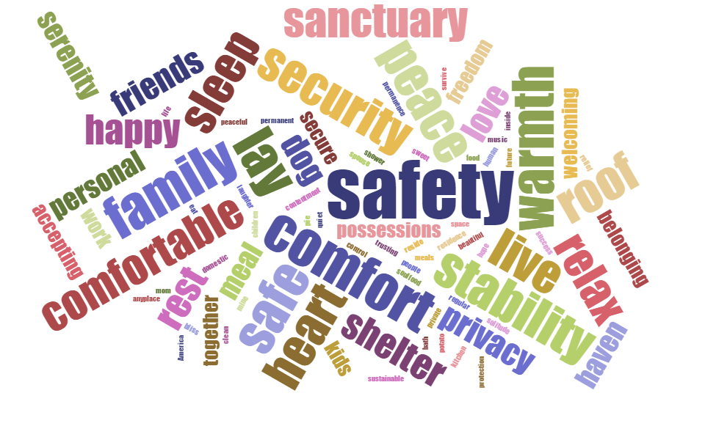

Slide 21
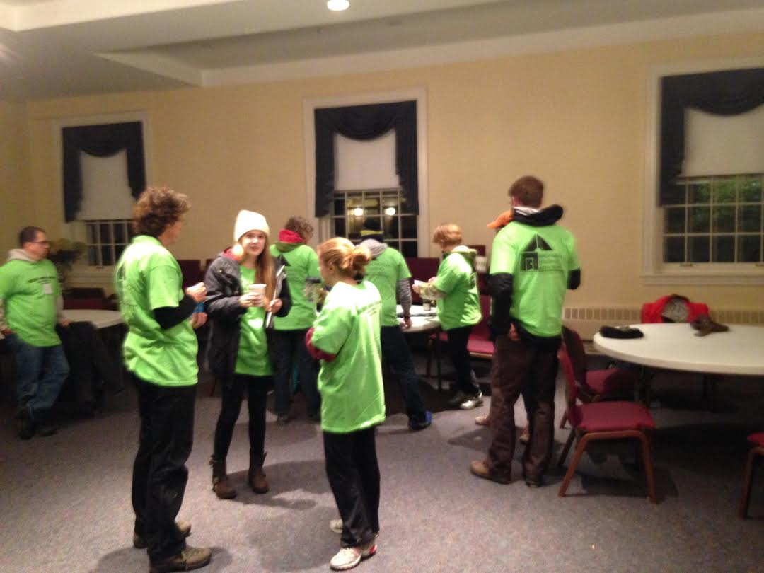

Slide 22
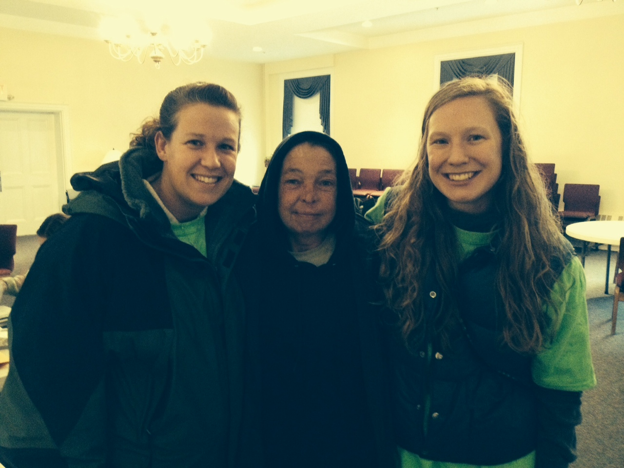

Slide 23
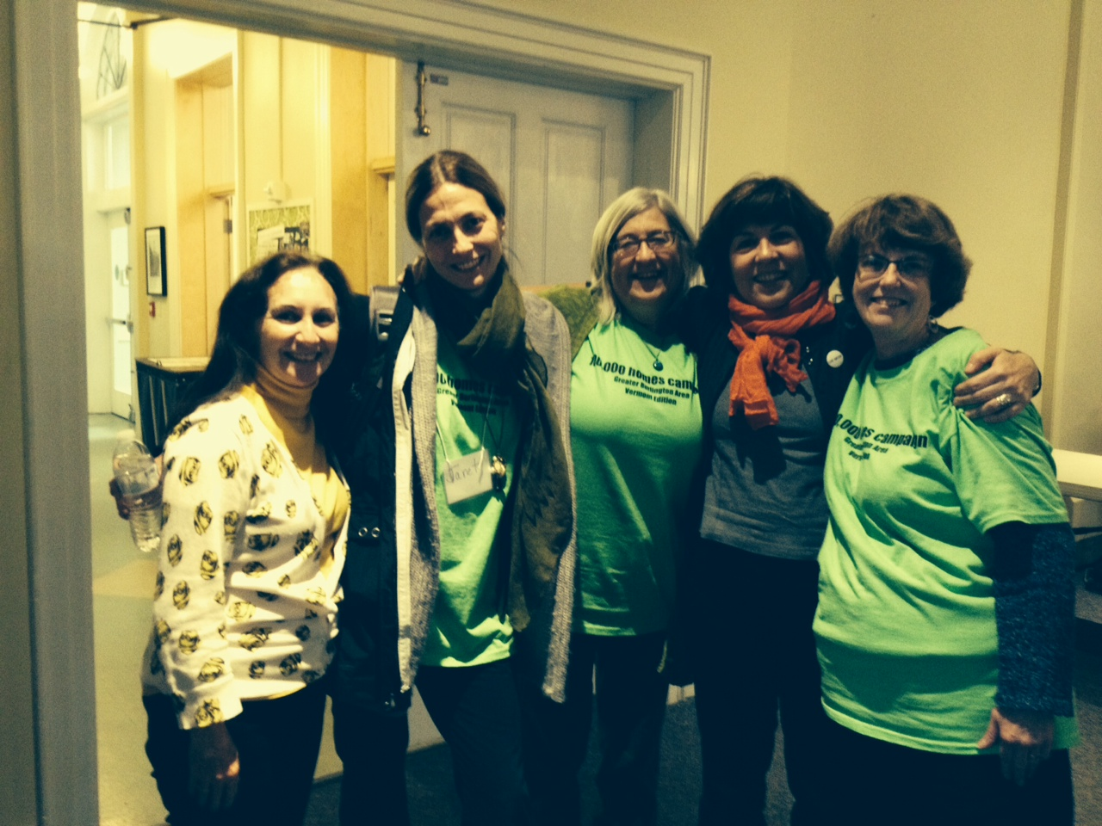

Slide 24
100,000 Homes Model
Housing First
Know who is out there
Track your progress
Goal: House 2-3 of the most vulnerable each month until everyone is housed
Improve Local Systems
Best practices, client-centered, measure program’s impacts

